Slide 1


M.Tech/MCA Program
Advanced Industry Integrated Programs
Jointly offered by University and LTIMindTree
Review III
RAG-Driven Intelligent Travel Recommendation and Personalized Itinerary Generation System
Team Member
Challapalle Venkata Sainath Reddy
VIT Chennai
T9997
Knowledge partner | Implementation partner

Slide 2
RAG-Driven Intelligent Travel Recommendation and Personalized Itinerary Generation System
Introduction
Travel planning requires information from multiple sources such as destinations, attractions, activities, accommodation, budgets and seasons.
Traditional recommendation systems often provide generic suggestions and may not match individual preferences.
Large Language Models can generate unsupported or outdated travel information without reliable external knowledge.
This project uses Retrieval-Augmented Generation (RAG) to retrieve relevant travel information and generate personalized recommendations and itineraries.

Slide 3
RAG-Driven Intelligent Travel Recommendation and Personalized Itinerary Generation System
Objective
Build a RAG-based intelligent travel recommendation system.
Provide personalized destination recommendations based on preferences, budget and trip duration.
Use semantic and keyword-based retrieval to find relevant travel information.
Generate practical day-by-day travel itineraries using retrieved information.
Reduce LLM hallucinations by grounding responses in the travel knowledge base.

Slide 4
RAG-Driven Intelligent Travel Recommendation and Personalized Itinerary Generation System
Modules to Cover
Module 1 – Data Ingestion & ETL: Clean, validate and load tourism and review data into PostgreSQL.
Module 2 – Travel Document Creation: Convert destination information into searchable RAG documents.
Module 3 – Embedding & FAISS Indexing: Generate BGE-M3 embeddings and create a local FAISS index.
Module 4 – Hybrid Retrieval & Reranking: Combine FAISS and BM25 retrieval and rerank using BGE Reranker.
Module 5 – RAG Generation & Web Application: Use Ollama with FastAPI and HTML/CSS/JavaScript to generate personalized itineraries.

Slide 5
RAG-Driven Intelligent Travel Recommendation and Personalized Itinerary Generation System
Problem Statement
Travelers need to collect information from multiple sources to plan suitable trips, making personalized itinerary creation time-consuming.
Existing recommendation systems may provide generic results instead of considering individual preferences, budget and duration.
LLMs can produce hallucinated or unsupported travel information when generating recommendations without reliable retrieved context.
A system is required to retrieve relevant travel knowledge and generate accurate, personalized and context-aware itineraries.

Slide 6
RAG-Driven Intelligent Travel Recommendation and Personalized Itinerary Generation System
Methodology
Raw travel datasets → Cleaning & validation → PostgreSQL.
Processed travel data → RAG document creation.
RAG documents → BGE-M3 embeddings → FAISS vector index.
User query → FAISS semantic retrieval + BM25 keyword retrieval.
Retrieved candidates → BGE Reranker → Top relevant documents.
Retrieved context + user query → Local Ollama LLM → Personalized recommendation and itinerary.
FastAPI exposes the RAG pipeline to the separate HTML/CSS/JavaScript frontend.

Slide 7
RAG-Driven Intelligent Travel Recommendation and Personalized Itinerary Generation System
Approach/Algorithms/Tools
RAG – Retrieval-Augmented Generation for grounded travel responses.
BGE-M3 – Generates semantic embeddings for travel documents and queries.
FAISS – Local vector indexing and similarity search.
BM25 – Keyword-based retrieval to complement semantic search.
BGE Reranker – Ranks retrieved documents by query relevance.
Ollama – Local LLM for recommendation and itinerary generation.
Python, PostgreSQL and FastAPI – Data processing, database and backend.
HTML, CSS and JavaScript – Separate web frontend.

Slide 8
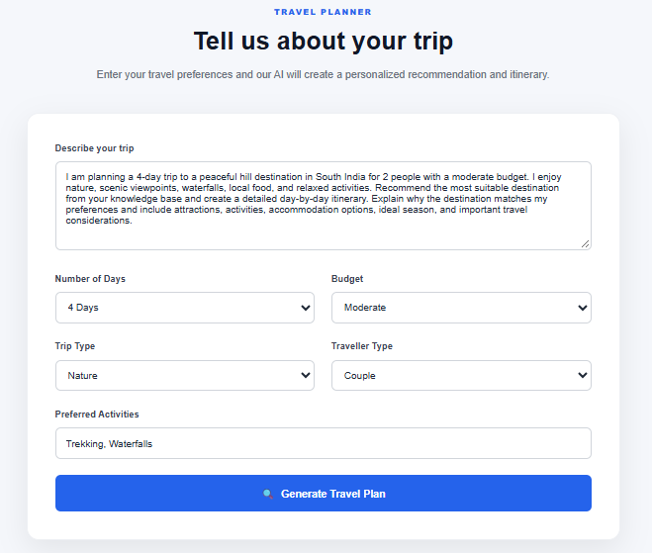
RAG-Driven Intelligent Travel Recommendation and Personalized Itinerary Generation System
Findings and Results

Slide 9
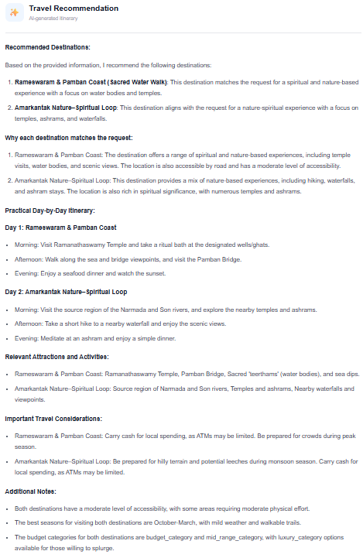
Findings and Results

Slide 10
RAG-Driven Intelligent Travel Recommendation and Personalized Itinerary Generation System
Conclusion
The system combines structured travel data, hybrid retrieval and generative AI for personalized travel planning.
FAISS and BM25 retrieve relevant travel knowledge, while BGE Reranker improves the quality of retrieved context.
The retrieved information is supplied to the local LLM to generate grounded recommendations and day-by-day itineraries.
The RAG architecture reduces dependence on unsupported LLM knowledge and improves contextual relevance.
Future work can focus on faster LLM inference, richer personalization and additional real-time travel information.

